Slide 1
Time-Aware User Embeddings as a Service
Martin Pavlovski^{1,*}, Jelena Gligorijevic^{2,*}, Ivan Stojkovic², Shubham Agrawal²,
Shabhareesh Komirishetty², Djordje Gligorijevic², Narayan Bhamidipati², Zoran Obradovic¹
¹ Center for Data Analytics and Biomedical Informatics
Temple University
Philadelphia, PA, USA
² Yahoo! Research
Verizon Media
Sunnyvale, CA, USA
* Contributed equally.
Notes:
Hello there,
My name is Martin Pavlovski and the paper I will be presenting today is titled "Time-Aware User Embeddings as a Service". This was a joint work between Temple University and Yahoo Research! within Verizon Media.

Slide 2
Motivation and Challenges
Motivation
Providing time-aware user/activity embeddings as a service to other teams in a company
Challenges
Task-independence
The stumbling block of user-level modeling
Requires analyzing user trails (sequences of user activities)
Need of a centralized and universal pool of user representations
Can be used for any type of advertising, user profiling, recommendations, etc.
individual teams are not burdened with efforts around understanding data, creating features, etc.
Compactness
Instead of using only a few readily available user features (like gender and age),
Other extreme: coming up with activity- or interest-based features
may result in billions of sparse features
Temporal-awareness
The intrinsic between-activity dependencies should be preserved
The irregular time gaps should be accounted for
Notes:
The motivation behind this work is to provide user and activity embeddings as a service to different teams in a company.
However, there are certain challenges that one might face when trying to build such a service system.
For instance, nowadays one way in which Digital Media companies try to understand the online behavior of users is by analyzing the activities that users perform online.
The history of activities a user performs are typically organized in a sequence, also called a user trail.
In digital media companies, these user trails are utilized by individual teams that work on different user-related prediction problems ranging from click or conversion prediction to recommendation or user segmentation.
These problems are also commonly addressed for various clients, advertisers or campaigns separately, thus introducing a separate prediction task for each.
However, every task depends upon specialized feature engineering that requires investing significant time and effort in redundant preprocessing for the teams involved.
Therefore, there's a need for a centralized and universal pool of user representations (also referred to as user embeddings).
Being provided with embeddings readily accessible and applicable to different tasks, the individual teams can avoid to be burdened around understanding the data, crafting features specific to their tasks, and so forth.
-------------------------
When it comes to the dimensionality of the user features, one approach is to use only a set of task-invariant user features such as demographic features which are usually accessible to all (or most of the teams) in digital media companies. These features are commonly used for various tasks due to their low cardinality.
However, this approach does not utilize any user activity data which is a rich source of information about user behaviour.
But, due to the large number of possible web activities that a user can perform, the number of resulting engineered features (such as one-hot encoded features, including cross-features) can be in the order of billions.
Then again, having to consider different activities for different tasks requires redundant construction of a huge number of features for each task which *then* introduces a notable computational burden to the individual teams.
-------------------------
Beside the high-dimensional user features, these redundant feature engineering efforts often produce features that disregard the time-varying nature of the online behavior of users.
Thus, learning temporally-aware user embeddings is another challenge that requires
(1) preserving the sequential dependencies between consecutive activities, as well as
(2) capturing the irregular time gaps between them

Slide 3
Problem Formulation
Given:
A sequence of user activities , along with their corresponding timestamps .
Objective:
Learn a function that projects a user to an embedding .
Learn user embeddings:
universal (task-independent)
compact (low-dimensional)
time-aware (preserves the temporal dependencies among a user’s activities)
such that
* the representations of users with similar activity histories are nearby in the embedding space.
Notes:
Formally,
Given a sequence (or trail) of user activities along with their corresponding occurrence timestamps, our objective is to learn a function that would project this user to a vector representation called a user embedding.
However, while learning, we also need to account for the aforementioned challenges according to which the learned user embeddings should be:
universal or task-independent
compact or low-dimensional
and time-aware (suggesting that the temporal dependencies should be preserved in the embeddings)
And, of course, users with similar activity histories should be embedded nearby in the embedding space.

Slide 4
Time-Aware User Embeddings as a Service
Time-Aware Sequential Autoencoder (TASA)
Learns task-independent embeddings by autoencoding sequences of user activities
Captures the sequential activity order by leveraging an LSTM-based encoder/decoder
Preserves between-activity time gaps by introducing stop features
Models the influence of activities and their timestamps by assigning temporal scores
Generates low-dimensional embeddings allowing for subsequently leveraging low-latency models
Service Pipeline
Stage 1: Generation of sequences (user trails)
Construction of user trails consisted of the top-K most frequent activities across multiple heterogeneous sources
Stage 2: Model Training
Incorporates TASA to learn time-aware embeddings of the user trails
Stage 3: Embedding Incoming Activities/Users
The trained TASA is used to embed incoming activities or entire user trails
Notes:
To that end, we propose the Time-Aware Sequential Autoencoder (or TASA in short).
TASA is an autoencoder model that learns time-preserving embeddings of user trails.
(1)
TASA embeds users in an unsupervised manner and considers all activities a user may perform instead of focusing on a subset of activities tailored for a certain task. This allows TASA to learn task-independent embeddings.
(2)
In the autoencoding framework, the sequential order of the activities is modeled by employing long short-term memory (LSTM) networks as encoder and decoder components.
(3)
The irregular time gaps between consecutive activities, on the other hand, are accounted for by the so-called stop features.
(4) Moreover, for a given user trail, temporal scores are assigned to each activity to model the influences that the activities and their timestamps have on the embedding of the entire trail.
(5) Finally, TASA generates compact, low-dimensional embeddings that allow for subsequently leveraging low-latency models to accommodate serving time.
-------------------------
Further, we designed a pipeline that integrates TASA to provide embeddings as a service in 3 stages:
In the first stage, frequent user activities from multiple sources are collected over a certain time period and organized into user trails.
TASA is then employed to learn to learn time-aware embeddings of the user trails.
AND From this point onward, the trained TASA model is used to embed incoming activities or entire user trails.

Slide 5
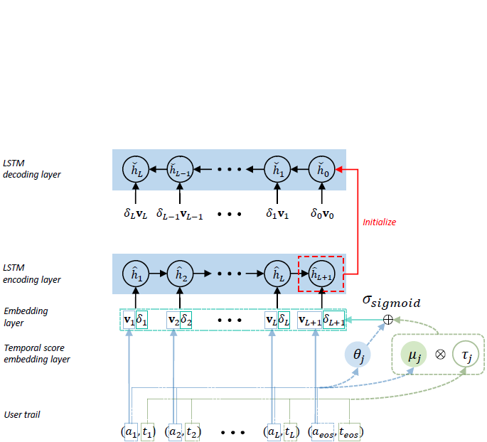
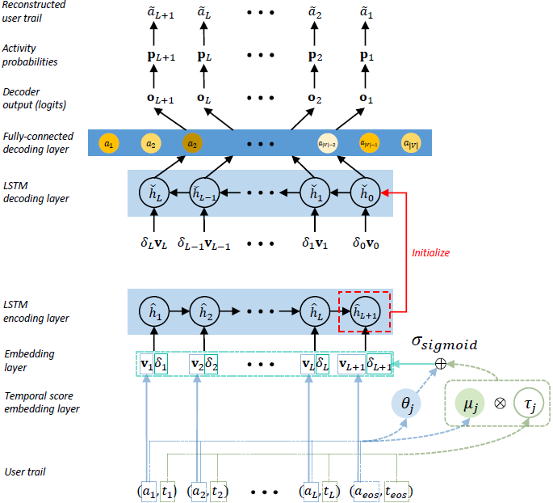
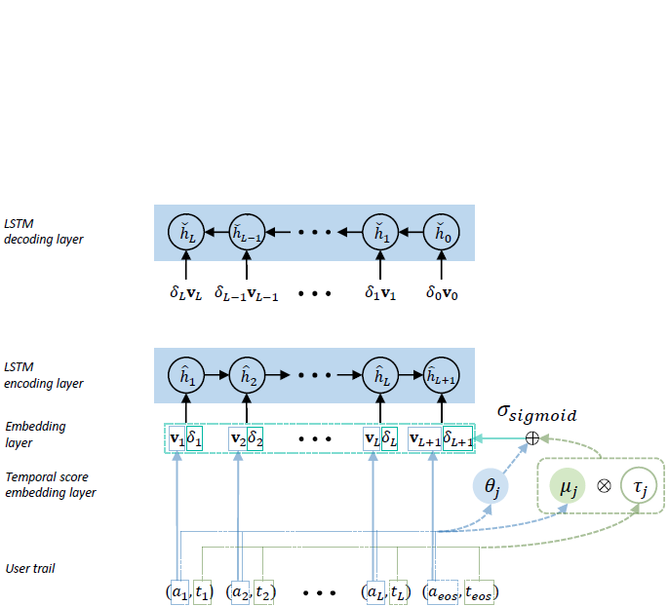
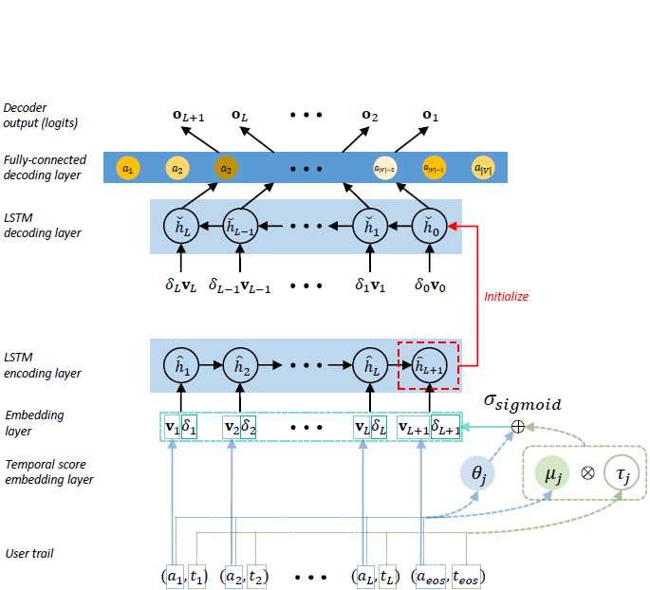
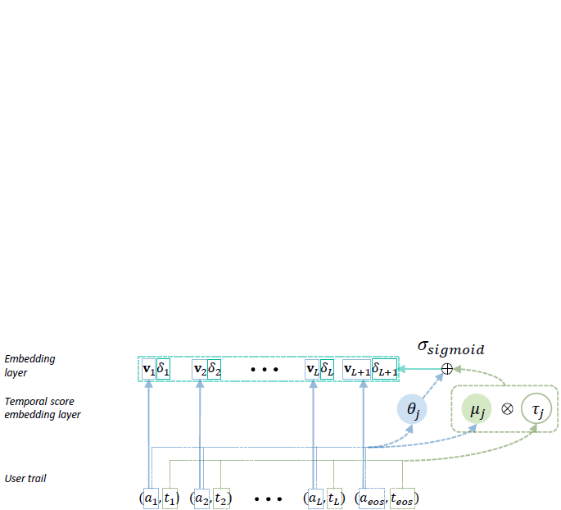
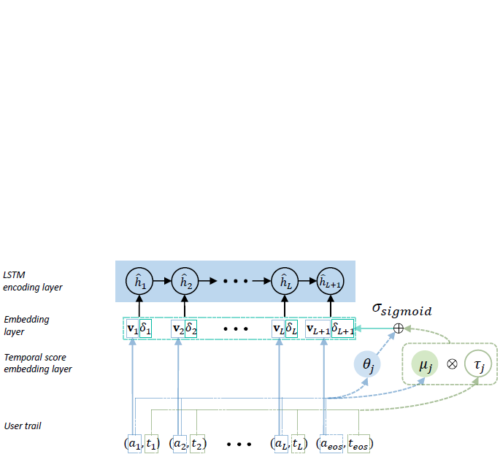
Time-Aware Sequential Autoencoder (TASA)
Notes:
The input to TASA is a sequence of activities {a1 to aL+1}, along with their corresponding timestamps {t1 to tL+1}.
-------------------------
Initially, every unique activity is assigned a separate embedding.
Then, to capture the irregular time intervals between consecutive activities, an additional stop feature tau_j is created for each activity a_j.
The intuition behind a stop feature suggests that it can act as an activity’s relative “closeness”, in time, to the end of a sequence.
In addition to the stop features, each activity aj is mapped to a pair of latent parameters θj and μj.
θj serves to model the initial influence of activities to the sequence embeddings, while μj and τj model the influence that activity timestamps have on the sequence embeddings.
The product of these two parameters is then added to the initial influence and passed through a sigmoid function to obtain a temporal score for each activity.
This way, by putting more attention to more recent occurrences, the temporal scores are intended to account for activities that occur in multiple instances within the same sequence.
Finally, the temporal scores are used to scale the activity embeddings accordingly.
-------------------------
Once the temporally-scored activity embeddings are generated, the sequences of activity embeddings are further encoded into low-dimensional representations. For this purpose, an LSTM network is utilized and the hidden state vector calculated at the last step is taken to summarize the entire user sequence into a user embedding.
-------------------------
Now, the hidden and cell states learned by the encoder LSTM are used to initialize another LSTM which acts as a decoder and seeks to reconstruct the original input sequence.
-------------------------
The reconstruction problem is treated as a multi-class classification problem in which the outputs of the LSTM decoder are passed to a fully-connected layer in order to predict (or, in this case, reconstruct) each activity from its preceding activity in the original sequence.
-------------------------
The outputs from the fully-connected layer are then passed through a softmax activation function to calculate the probabilities for each activity based on which the original input sequence is reconstructed.
-------------------------
So, what I just described is TASA's forward-pass procedure for one user sequence.
Now, for a set of N user sequences, all of them are passed forward through the architecture and the total loss is calculated as the sum of the decoder's logistic losses for all sequences.
The gradients w.r.t. to the total loss are propagated back through the entire architecture
AND
In this manner, the encoder and decoder components are trained back-and-forth until convergence.

Slide 6
Data
YooChoose Public Dataset
Source: RecSys 2015 Challenge (http://recsys.yoochoose.net)
Activities: Clicks/buys of users over time
Examples: 4, 428, 037 user sessions of activities
3, 985, 870 sessions in the training set | 442, 167 in the test set
4, 050, 782 sessions labelled as negative | 377, 255 as positive
Vocabulary: 52, 739 unique activities
User Activity Trails from Verizon Media
Millions of user activity sequences from heterogeneous sources:
Yahoo Search
Commercial email receipts
News and other content on publishers’ webpages associated with VM such as:
Yahoo homepage, Finance, Sports and News, advertising data (e.g., ad impressions and clicks)
Vocabulary: 200,000 most frequent activities
Conversions (labels) collected over one month for 3 different advertisers
Selected 5% of the positive conversions
Divided into training, validation and test sets using cut-off dates
Notes:
Experimentation was conducted on both public and proprietary data.
First, we conducted purchase prediction experiments on a publicly available dataset obtained from the RecSys Challenge in 2015, which contains of sequences (sessions) of click events with respective timesteps from the Yoochoose website.
There are 4, 428, 037 sessions in the entire dataset.
Around 4 million of those ended with a purchase event and are therefore assigned positive labels, while the rest 377,000 or so are labeled as negative.
There were somewhat less than 4 million sessions in the training set, and around 442,000 in the test set.
After preprocessing, the vocabulary for this dataset contained 52, 739 unique activities.
===============
We also conducted experiments using millions of user activity trails data from Verizon Media.
This includes activities chronologically collected for users, derived from heterogeneous sources, for example, Yahoo Search, commercial email receipts, news reads and other content on publishers’ webpages associated with Verizon Media.
All unique activities across these trails were sorted by frequency and the 200,000 most frequent were selected to build the vocabulary.
The labels were assigned as conversions for 3 different advertisers over a one-month period.
Accordingly, if a user converted for a specific advertiser, its corresponding user trail was labeled as positive. Otherwise, it was labeled as negative.
Also, negative downsampling was performed here to maintain roughly 5% of the positives for all advertisers.
And, of course, for each advertiser, the user trails were divided into training, validation and test sets using cut-off-dates.

Slide 7
Experimental Setup
Baselines
Unsupervised
AE: Fully-Connected Autoencoder
seq2seq: Seq2seq Autoencoder [1]
TA-seq2seq: Time-Aware Seq2seq [2, 3]
ISA: Integrated Sequence Autoencoder [4]
Supervised
LR: Logistic Regression
attRNN: Attention-based RNN [5]
XGBoost: eXtreme Gradient Boosting [6]
[1] Sutskever, et al. “Sequence to sequence learning with neural networks.” NIPS 2014.
[2] M. Baytas, et al. “Patient subtyping via time-aware LSTM networks.” SIGKDD 2017.
[3] Bai, et al. “Interpretable representation learning for healthcare via capturing disease progression through time.” SIGKDD 2018.
[4] Pei and MJ Tax “Unsupervised Learning of Sequence Representations by Autoencoders.” arXiv preprint 2018.
[5] Zhou, et al. “Understanding consumer journey using attention based recurrent neural networks.” SIGKDD 2019.
[6] Chen, et al. “XGBoost: A Scalable Tree Boosting System.” SIGKDD 2016.
Notes:
TASA was compared against several baselines, both unsupervised and supervised.
Among the unsupervised baselines
We considered a conventional autoencoder that uses fully-connected layers to perform encoding and decoding.
A Seq2seq Autoencoder which uses LSTM-based encoder and decoder.
A Time-Aware LSTM autoencoder that accounts for irregular time gaps between sequence elements.
AND
An Integrated Sequence Autoencoder that account for both (1) the global silhouette information and (2) the local temporal dependencies within a sequence.
On the other hand, conventional Logistic Regression, an attention based Recurrent Neural Network, and eXtreme Gradient Boosting were considered as supervised baselines.

Slide 8
Experimental Setup
Evaluation metrics
Unsupervised
Reconstruction Accuracy
ROUGE (Recall-Oriented Understudy for Gisting Evaluation) [7]
BLEU (BiLingual Evaluation Understudy) [8]
Supervised
Area Under the ROC curve (AUC)
Setup
Embedding dimension: 100
Optimizer: Adam with a learning rate of 0.001
Batch sizes:
VM user trails: 32
RecSys dataset: 64
Ran on a distributed TensorFlowOnSpark infrastructure
100 Spark executors
Model parameters distributed among 5 executors.
[7] Lin. “Rouge: A package for automatic evaluation of summaries.” Text summarization branches out, 2004.
[8] Papineni, et al. “BLEU: a method for automatic evaluation of machine translation.” ACL 2002.
Notes:
For evaluating the sequence reconstruction capabilities of the models, we used reconstruction accuracy, ROUGE (or Recall-Oriented Understudy for Gisting Evaluation), and BLEU (or BiLingual Evaluation Understudy).
As for the downstream classification tasks, we assessed the models w.r.t. Area Under the ROC Curve.
===============
As for the experimental setup, the activity and user embedding dimensions were set to 100.
TASA and the baseline models were trained for 10 epochs using the Adam optimizer with a learning rate of .001.
The gradient updates on the public and proprietary datasets were performed using batch sizes 32 and 64, respectively.
All approaches were run on a distributed TensorFlowOnSpark infrastructure such that each model was run on 100 Spark executors, while the model parameters were distributed among 5 executors.
===============
Using this experimental setup, two sets of experiments were conducted, one focusing on
(1) the reconstruction capability of the considered approaches, while
(2) the other experimental set was designed to assess the embedding quality with respect to several supervised tasks.

Slide 9
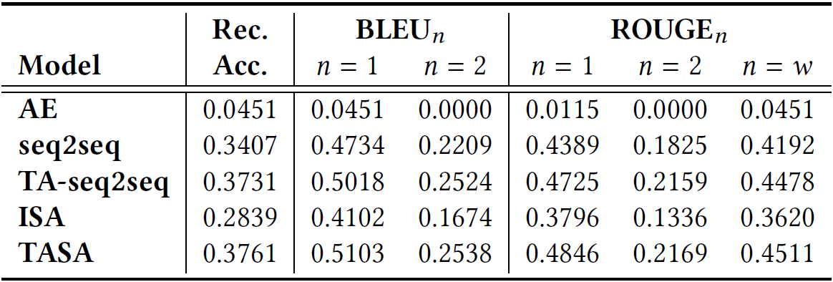
Results – Sequence Reconstruction
Proprietary VM dataset
Discussion:
TASA outperforms the alternatives, across all reconstruction measures.
Leveraging temporal information (by TA-seq2seq and TASA) leads to more accurate reconstruction
Nonetheless, seq2seq greatly outperforms AE
sequential modeling is an important basis for capturing the sequential nature of the user trails
Reconstruction performance on the VM dataset.
Notes:
TASA was first compared against the baselines on the sequence reconstruction task, using the proprietary VM activity data.
The results suggest that TASA outperforms the alternative approaches, across all sequence reconstruction measures.
However, what is (also) interesting is that
approaches which take into consideration the temporal aspect of the data, such as TA-seq2seq and TASA, do better at capturing the information needed for more accurate sequence reconstruction than the approaches that don't utilize this information.
and also, seq2seq greatly outperforms the conventional autoencoder, indicating that the sequential information modeling performed by LSTM autoencoders seems to be an important basis for capturing the sequential nature of the user trails.

Slide 10
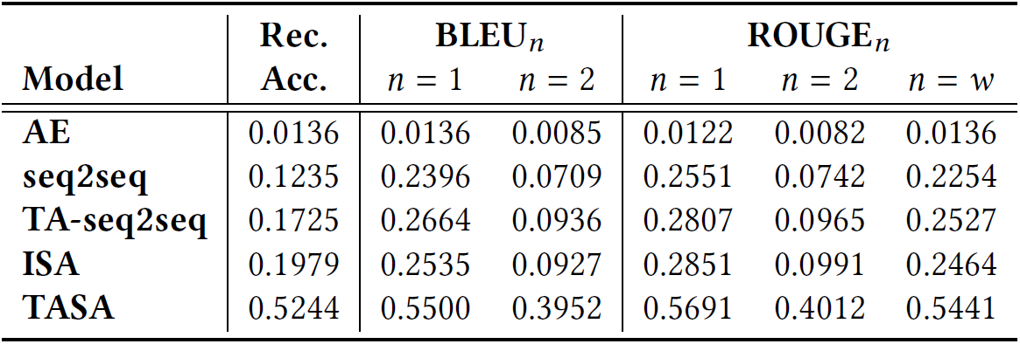
Results – Sequence Reconstruction
Public RecSys dataset
Discussion:
AE, seq2seq, TA-seq2seq and TASA seems to obtain consistent performance
Once again:
seq2seq outperforms AE
the time-aware variants manifest improvements over the ones that do not preserve time
ISA specifically exhibits considerable performance (the second-best performing)
TASA consistently outperforms other alternatives across all measures
Larger improvements than those on the VM data
Reconstruction performance on the RecSys dataset.
Notes:
Reconstruction evaluation was also performed on the public dataset.
The performances of AE, seq2seq, TA-seq2seq and TASA on this dataset seem to be somewhat consistent with their performances on the proprietary dataset.
Once again, seq2seq outperformed AE and the time-aware variants manifested improvements over the ones that do not preserve time. ISA specifically exhibited better performance relative to the other approaches, being the second-best performing model.
TASA, however, consistently outperformed the other alternatives across all evaluation measures, here showing even larger performance improvements than those obtained on the proprietary data.

Slide 11
Results – Conversion Prediction
Company baseline: uses user demographic data
* The AUC lifts are computed with respect to this baseline.
All LR models from the left section of the table are trained on user demographic features concatenated with
user embeddings. As for the right section of the table, the models are trained on one-hot encoded activities.
Proprietary VM dataset
The demographic data is not sufficient
One-hot LR slightly improves the baseline
With user embeddings + demographic features, TASA yields:
> 25% in AUC on Advertiser A
> 10% on Advertiser B
> 15% on Advertiser C
Although LR is a supervised model, when trained on unsupervised embeddings, it attains greater performance
due to the sequential nature of the trails:
captured by the sequential variants
not by LR 1-hot
LR achieves its highest performance:
When trained on TASA’s user embeddings
Even achieves comparable performance to attRNN
Notes:
The learned vector representations were further tested on supervised predictive tasks involving conversion prediction for 3 different advertisers.
For these three proprietary datasets, a baseline approach was used to build predictive models using users' demographic data and the lift in AUC was computed for the rest of the models with respect to this baseline.
The user embeddings learned from the unsupervised models were appended to these demographic data and an LR model was learned on the resulting concatenated features.
In addition, two more supervised approaches were compared: an LR learned on 1-hot encoded activity features and an attRNN learned on user sequences, both concatenated with user demographics.
-------------------------
From the obtained results, it is clear that using only the demographic data is not sufficient.
LR trained on the one-hot encoded user activities improves this performance.
Nevertheless, once the user embeddings are concatenated to the demographic features, the improvements in AUC are evident. In particular, the proposed TASA achieves an improvement of > 25% in AUC on Advertiser A, > 10% on Advertiser B, and > 15% on Advertiser C.
This indicates that, although LR is trained in a supervised manner, when trained on unsupervised user embeddings it still attains greater predictive performance. This is most likely due to the sequential information within the user trails that is being captured by the sequential autoencoder variants, but not by LR trained on a simple one-hot transformation of the user activities.
-------------------------
However, LR achieves its highest performance when trained on TASA’s user embeddings, rather than on the embeddings produced by any other autoencoder variant.
It even achieves comparable performance to the supervised attRNN model.
This is of considerable importance since TASA learned the user embeddings not being aware of the prediction target as opposed to attRNN that was tailored for each task separately.
In addition, attRNN requires to be retrained for each task which consumes a significant amount of time, while TASA can be trained offline once and then, for each task, a simple LR model can be efficiently trained on TASA's low-dimensional embeddings.

Slide 12
Results – Purchase Prediction
Public RecSys dataset
LR(TASA) consistently outperforms the alternatives
Almost as good as attRNN
Sequential and/or time-aware variants outperform the one-hot LR
Predictive performance in terms of AUC on the (public) RecSys 2015 challenge dataset.
Observations:
⇨ TASA can be trained offline once and readily applied across tasks
⇨ Allows for subsequently leveraging low-latency models to accommodate serving time
Notes:
TASA and its alternatives were also assessed on the public RecSys dataset for the task of purchase prediction.
Consistent with the previous observations, LR trained on TASA's embeddings convincingly outperformed the competitive autoencoder approaches, while being almost as good as attRNN.
And once again, all models that account for sequential and temporal data aspects outperformed the LR variant trained on the one-hot encoded sequences.
-------------------------
And from the experiments carried out on both the proprietary and the public datasets, our general observation is that
the benefit of TASA is that it can be trained offline ONCE and then readily applied across multiple prediction tasks (the same way it was applied for different conversion prediction tasks across multiple advertisers)
this will allow for leveraging low-latency models which, if needed, can be efficiently retrained on TASA’s compact embeddings to accommodate serving time.

Slide 13
Service Pipeline
A Bird’s-eye View
sequence generation
input
Model Training
output
Data Sources
user trail
user embedding
Conversion Prediction
Click Prediction
Model weights
Centralized pool of embeddings
Encoded representation
Ad Recommendation
incoming sequence of activities
Apply Model
user embedding
Notes:
TASA was also incorporated within a service pipeline designed to provide time-aware (user) embeddings as a service.
%Generally speaking, the service takes a collection of user trails as an input and periodically generates time-aware embeddings of the trails and their constituent activities.
In the service system, the activities that users perform over a certain period of time are queried from multiple heterogeneous sources and organized into user trails.
The user trails are then used to train TASA.
Upon training, the resulting time-aware user embeddings that TASA generates are stored in a centralized pool of embeddings along with TASA's parameters.
From this point onward, the stored TASA model can be directly applied to generate a new, or update the existing, embedding of any incoming user trail, or individual activity.
At all times, different teams have access to the centralized pool of embeddings and can therefore directly leverage the user/activity embeddings for their individual tasks, without the need of any feature engineering or manual preprocessing interventions.

Slide 14
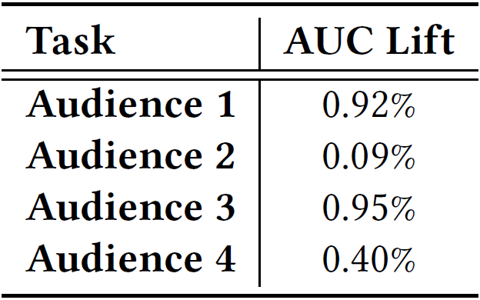
Service Pipeline – Conversion Prediction
* Utilized by several teams as a source of additional user features, mainly for offline experimentation
Pipeline Evaluation
Offline experiments
Data: Four sets of audiences
Task: Conversion prediction
Relative AUC lifts
XGBoost utilizing TASA’s + current production features
Relative to a model built using only the production features
Note:
The production system is a very strong baseline as it utilizes a set of features that have been refined over many years and are already achieving high predictive performance.
Since audiences consist of over a billion users each, even a lift of about 0.5% is substantial and can make a difference given the high volume of predictions the model is expected to make.
Performance improvements introduced by the service pipeline on four in-house conversion prediction tasks.
Notes:
The service pipeline is currently utilized by several teams as a source of additional user features, mainly for offline experimentation.
Accordingly, to evaluate the performance of the entire pipeline, we have conducted offline experiments on four sets of audiences.
The lifts in AUC were calculated by comparing an XGBoost model that utilizes the TASA-generated embeddings in addition to the current production features, relative to an XGBoost model built only on the production features.
In the cases of all four audiences, we have observed lifts in conversion prediction performance as a result of using the TASA-generated user embeddings *along with* the production features
But what I just want to stress here is that you should be aware that the baseline against which the pipeline is compared is a very strong baseline because it utilizes production features which have been handcrafted and refined over many years and are already achieving high predictive performance.
Moreover, considering that the performance evaluation is carried out on audiences consisting of over a billion users each, even a lift of about 0.5% is substantial and can make a difference given the large volume of predictions the model is expected to make.

Slide 15
Thank you!
Notes:
Aaaand, with this I would like to conclude this presentation and to thank you for your attention.

